Slide 1
Purchase Pattern Analysis
Client Project Report
Project ID: CDACL005
Team Code: PTID – CDA – SEP - 25 -741
Batch: 12 – MAY – CDA – BUN – 040 – WDM1130 – BAN
Prepared By: Pruthiraj Samal (pruthirajsamal8802@gmail.com)

Slide 2
Objectives
🏁 Project Kick-off and Data Exploration
Understand project goals, load dataset, and perform initial exploratory data analysis.
🧹 Data Cleaning and Transformation
Handle missing values, outliers, and prepare dataset for analysis.
📊 Data Visualization and Apriori Algorithm Implementation
Visualize product patterns and generate association rules.
💡 Insights, Recommendations, and Finalization
Summarize findings, provide actionable insights, and finalize deliverables.

Slide 3
Overview
Objective:
Discover customer buying patterns from transaction data.
Business Value:
Helps in cross-selling, promotions, and inventory optimization.
Methodology:
Data Collection
↓
Data Cleaning
↓
Apriori Algorithm
↓
Insights & Recommendations

Slide 4
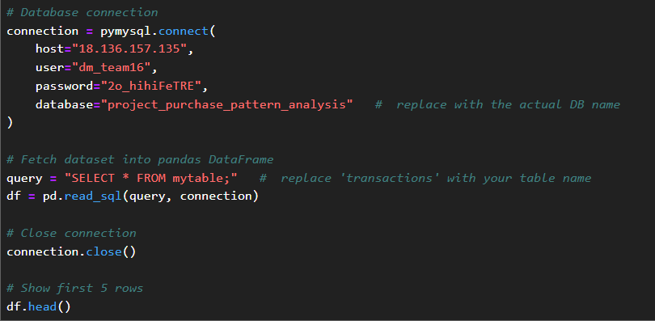
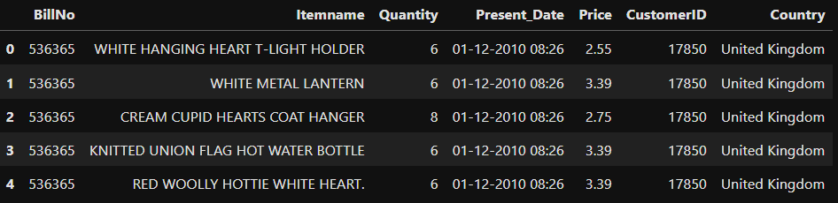
Kick-off & Data Exploration
Define objectives & expectations
Understand the project goals and what the team aims to achieve.
Load transaction dataset
Import the dataset into the analysis environment for processing.

Slide 5
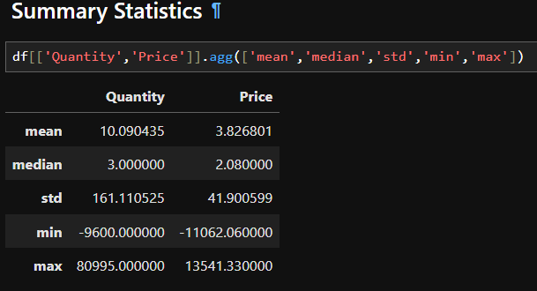
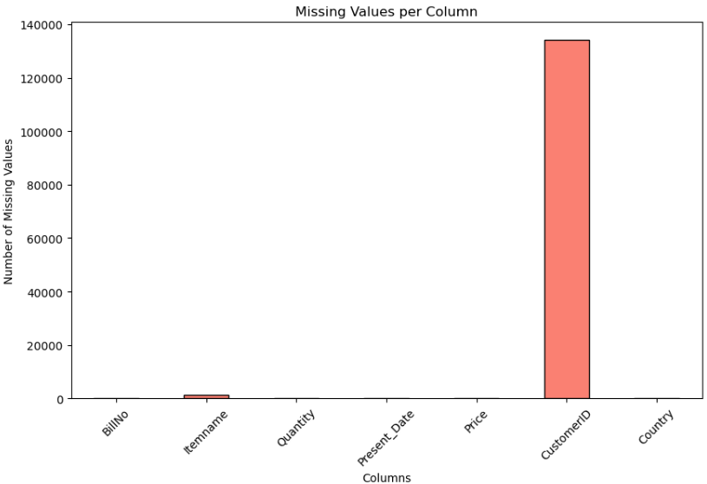
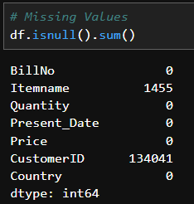
Perform EDA: summary stats, distributions, outliers
Explore the data to identify patterns, key statistics, and any anomalies.

Slide 6
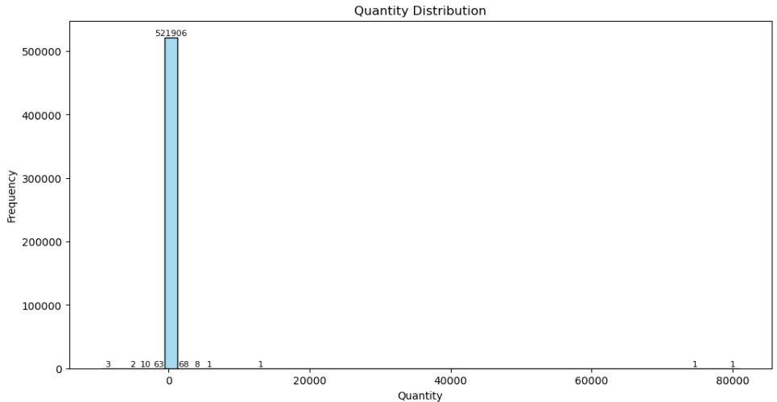
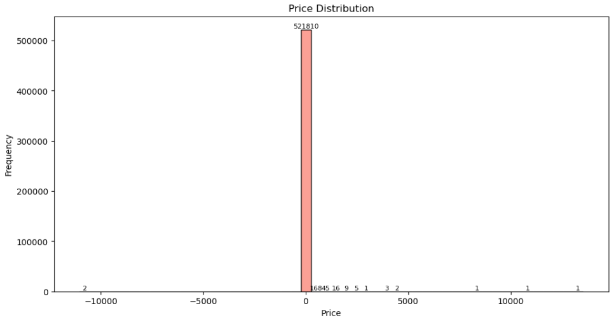
Kick-off & Data Exploration
Data Distribution Visualizations

Slide 7
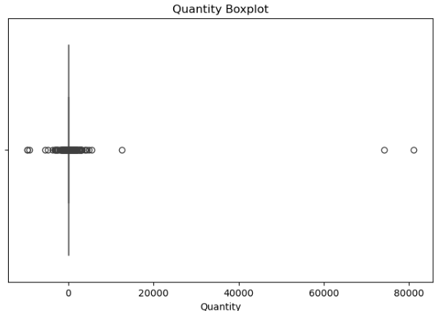
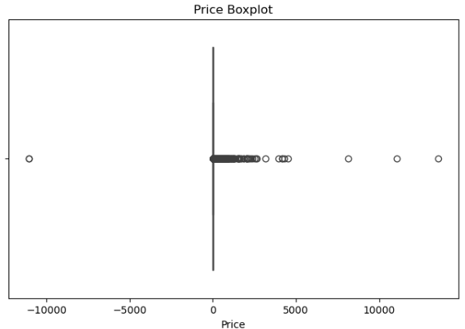
Kick-off & Data Exploration
Detect Outliers

Slide 8
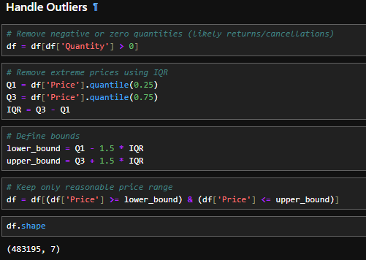
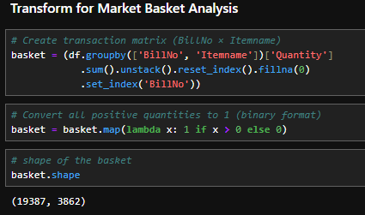
Data Cleaning & Transformation
Handle missing values & outliers
Identify and correct missing or abnormal data points to ensure data quality.
Fix inconsistencies in dataset
Standardize formats, remove duplicates, and correct any errors in the data.
Transform dataset for MBA
Convert the data into the appropriate format required for market basket analysis.

Slide 9
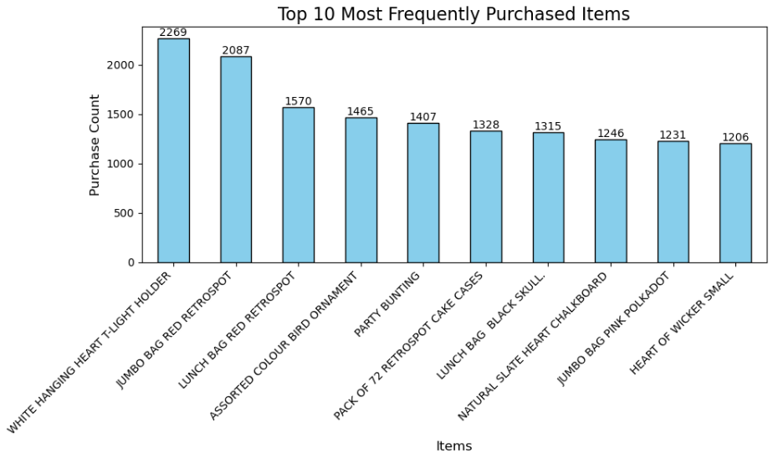
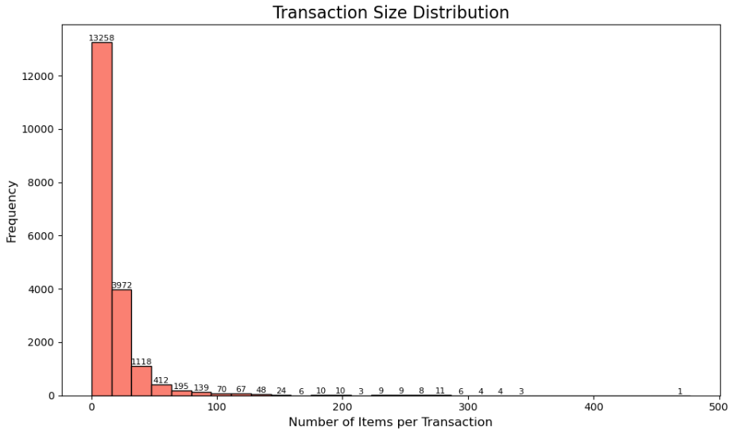
Visualization & Apriori Implementation
Visualize product occurrences & trends
Create charts and graphs to understand product popularity and buying patterns.
Implement Apriori algorithm
Apply the Apriori algorithm to identify relationships between items in transactions.
Generate frequent itemsets & association rules
Discover patterns and rules that indicate which products are often bought together.

Slide 10
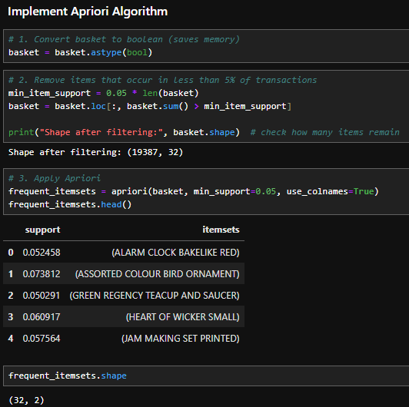
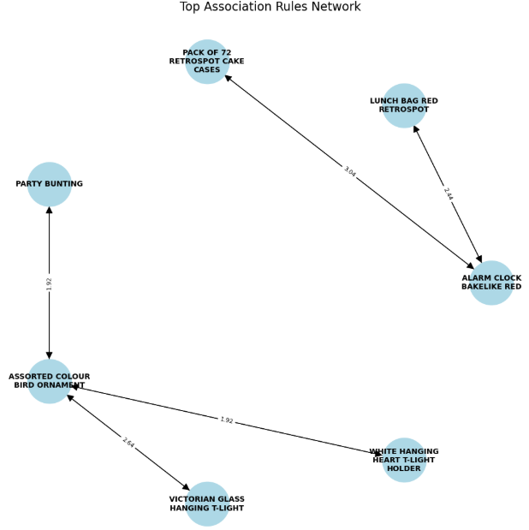
Visualization & Apriori Implementation

Slide 11
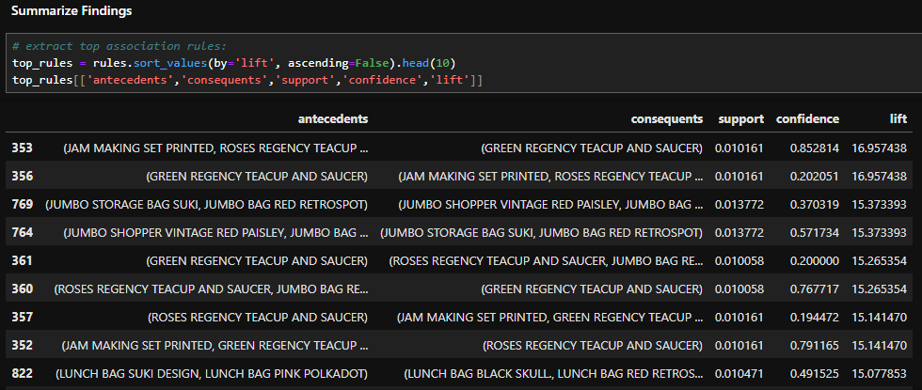
Insights & Recommendations
Summarize findings from Apriori analysis
Highlight key patterns, frequent itemsets, and strong association rules.
Provide actionable recommendations for business
Suggest strategies like product bundling, cross-selling, or promotions based on the analysis.
Prepare final documentation & presentation
Compile the analysis, charts, and insights into a comprehensive report and presentation.

Slide 12
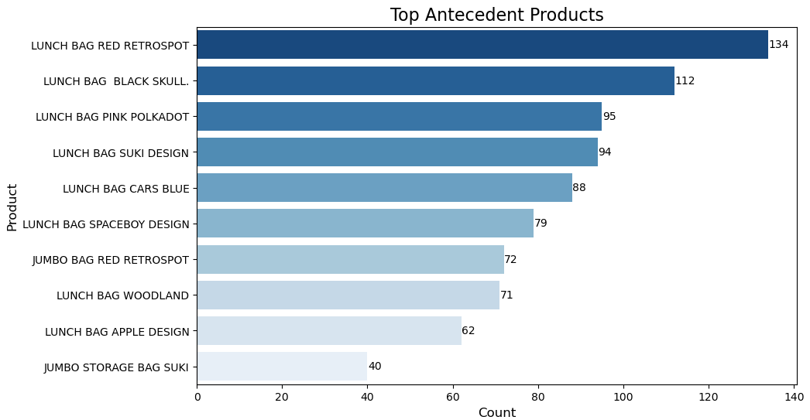
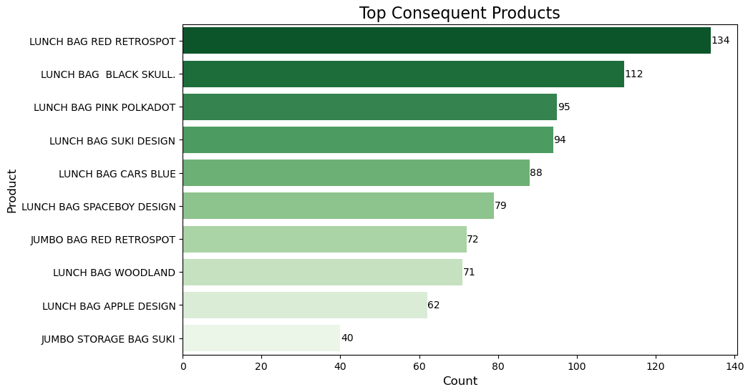
Insights & Recommendations

Slide 13
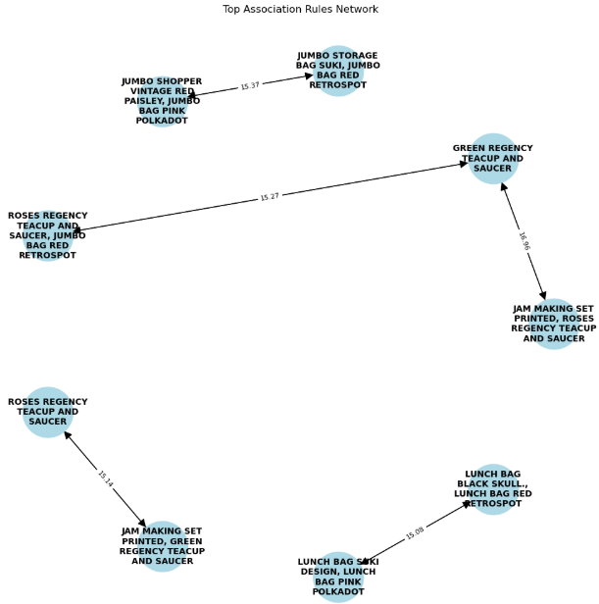
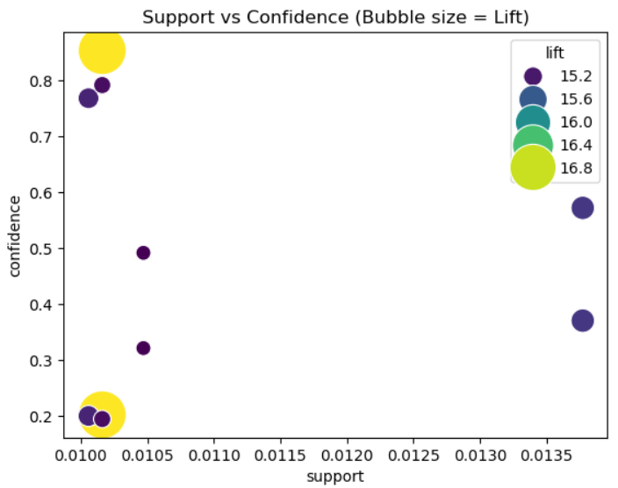
Insights & Recommendations

Slide 14
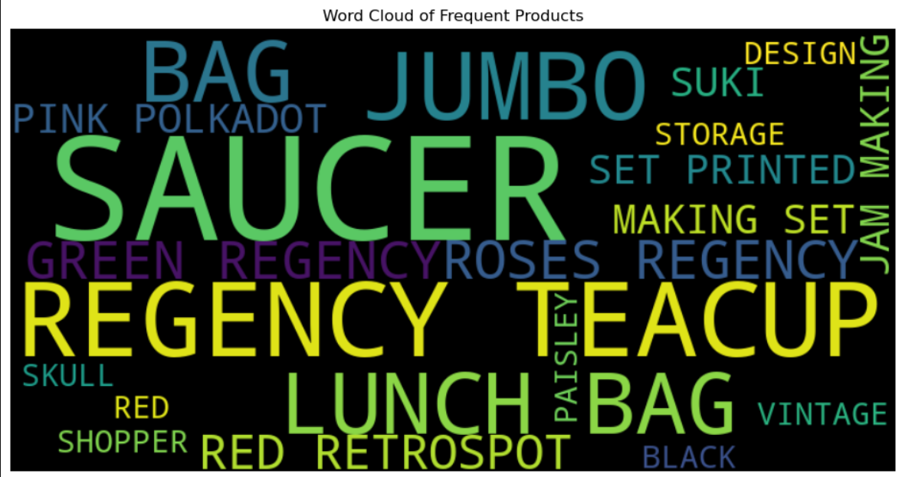
Insights & Recommendations

Slide 15
Review & Iteration
Conduct team review of results
The team goes through all the analysis, charts, and findings together.
Purpose: Make sure everyone understands the results and nothing is missed.
Address feedback & improve analysis
Incorporate suggestions or corrections from the team or stakeholders.
Purpose: Refine the analysis to make it more accurate and reliable.
Finalize all project deliverables
Ensure all data, visualizations, reports, and insights are complete and polished.
Purpose: Prepare everything for presentation or submission.

Slide 16
THANK YOU

